Slide 1
Luke 2: 1-20
1At that time the Roman emperor, Augustus, decreed that a census should be taken throughout the Roman Empire. 2 (This was the first census taken when Quirinius was governor of Syria.) 3 All returned to their own ancestral towns to register for this census. 4 And because Joseph was a descendant of King David, he had to go to Bethlehem in Judea, David’s ancient home. He traveled there from the village of Nazareth in Galilee. 5 He took with him Mary, to whom he was engaged, who was now expecting a child.

Slide 2
Luke 2: 1-20
6 And while they were there, the time came for her baby to be born. 7 She gave birth to her firstborn son. She wrapped him snugly in strips of cloth and laid him in a manger, because there was no lodging available for them.
8 That night there were shepherds staying in the fields nearby, guarding their flocks of sheep. 9 Suddenly, an angel of the Lord appeared among them, and the radiance of the Lord’s glory surrounded them. They were terrified, 10 but the angel reassured them. “Don’t be afraid!” he said. “I bring you good news that will bring great joy to all people.

Slide 3
Luke 2: 1-20
11 The Savior—yes, the Messiah, the Lord—has been born today in Bethlehem, the city of David! 12 And you will recognize him by this sign: You will find a baby wrapped snugly in strips of cloth, lying in a manger.”
13 Suddenly, the angel was joined by a vast host of others—the armies of heaven—praising God and saying,
14 “Glory to God in highest heaven, and peace on earth to those with whom God is pleased.” 15 When the angels had returned to heaven, the shepherds said to each other, “Let’s go to Bethlehem! Let’s see this thing that has happened, which the Lord has told us about.”

Slide 4
Luke 2: 1-20
16 They hurried to the village and found Mary and Joseph. And there was the baby, lying in the manger. 17 After seeing him, the shepherds told everyone what had happened and what the angel had said to them about this child. 18 All who heard the shepherds’ story were astonished, 19 but Mary kept all these things in her heart and thought about them often. 20 The shepherds went back to their flocks, glorifying and praising God for all they had heard and seen. It was just as the angel had told them.

Slide 5
Anthems of Christmas
Expectation – Elisa Dickenson
Preparation – Denise Hyland
Proclamation – Greg Mellow
Revelation – Kay Brown
Christmas Day – Philip Adams

Slide 6
Anthems of Christmas
Proclamation – Luke 2:1 - 21
Greg Mellow

Slide 7
Proclamation
Census for taxation purposes
Where was Jesus born?
Bethlehem?
Stable?
Cave?
House?

Slide 8
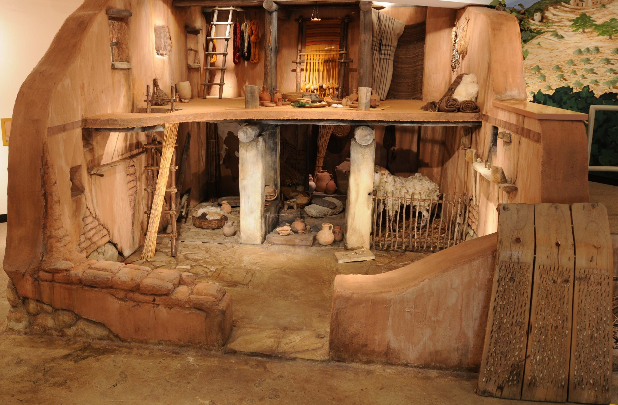

Slide 9
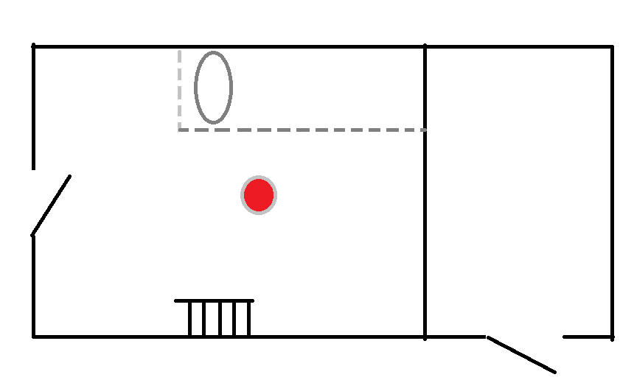
Manger
Kataluma

Slide 10
Proclamation
Setting: Time & Place
Scene 1: the birth - Joseph, Mary & baby
Scene 2: the announcement – shepherds & angels
Scene 3: the confirmation - everyone
Response: Mary - thoughtful,
the people - amazed,
the shepherds - joyful

Slide 11
Proclamation
One question: Why shepherds?
Four Words: Good-news, Saviour, Christ, (the) Lord
The 'Anthem'

Slide 12
The “Anthem”
Luke 2:14
Glory to God in the highest and on earth peace to people who are pleasing (to God).

Slide 13
The Anthem
Verb | Place | join | Place | Verb
(Give) glory to God | in the highest | and | on earth | (God grants) peace to (God) pleasing people

Slide 14
The Anthem: Peace
Peace, eirene, shalom
(not war), harmony, safety, prosperity, peace of mind, wellbeing …
Not chaos ...

Slide 15
The Anthem: Peace
A Cosmic Struggle
Gen 1:2 … formless, dark, deep waters vs … the Spirit
Chaos vs …
Harsh realities of life vs … peace & hope

Slide 16
The Anthem: Peace
Harsh Realities in Jesus life
Foreign troops, puppet govt, collaborators, taxation
Militants, religious legalists, racial / cultural conflict
Rich / poor, relationship breakdown
Disease, disability, discrimination, executions
Joseph ?, friend's death, rejected by family, reputation assassination - mad, death threats

Slide 17
The Anthem: Peace
Peace of mind?
Augustine – original sin
Kirkegaard & Freud - 'angst', inner turmoil
Solzhenitsyn – “the battleline between good and evil lies in the heart of every man.
Anxiety, Self-esteem, Regrets, Shame

Slide 18
God's Peace for today
Jesus: Blessed are the peace makers
- Harmony, wellbeing, prosperity
Paul: The fruit of the Spirit is … peace
If it is possible, as far as it depends on you, live at peace with everyone Rom12:18
Be joyful in hope, patient in affliction, faithful in prayer Romans 12:12

Slide 19
God's Peace for this Christmas
The Angels:
Good News - Jesus is Saviour, Christ, the Lord
thoughtful, awe struck / confused, joyful?
giving glory and praise to God

